Slide 1
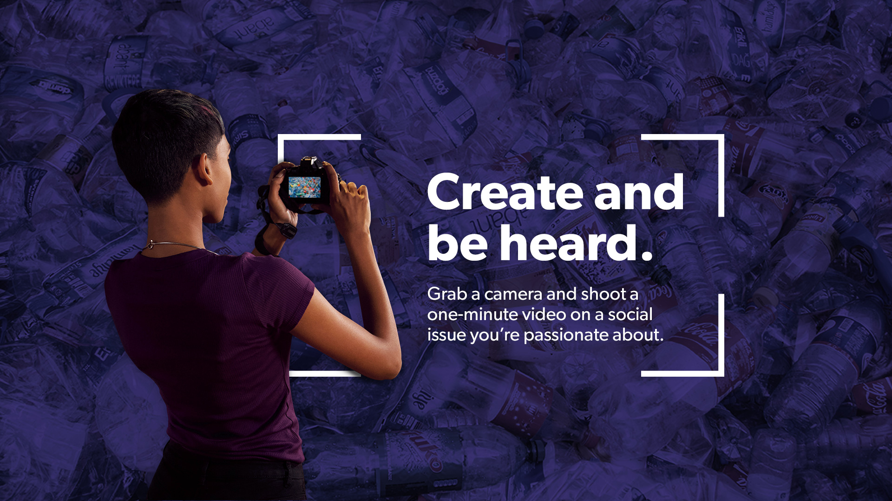

Notes:
Suggested Scripting
Videos for Change is a really powerful way to create, be heard and lead social change on the issues that we’re passionate about

Slide 2
Notes:
Suggested Scripting
Share key points about how it works:
Create a one-minute video on a social issue they care about changing
The challenge is open to all Australian students in Years 7-12
They can have up to 6 people in their team and can even enter alone if they want to
Explain that this is not just about the chance to win a competition but an opportunity to act as leaders and inspire others to make the world a fairer and better place

Slide 3

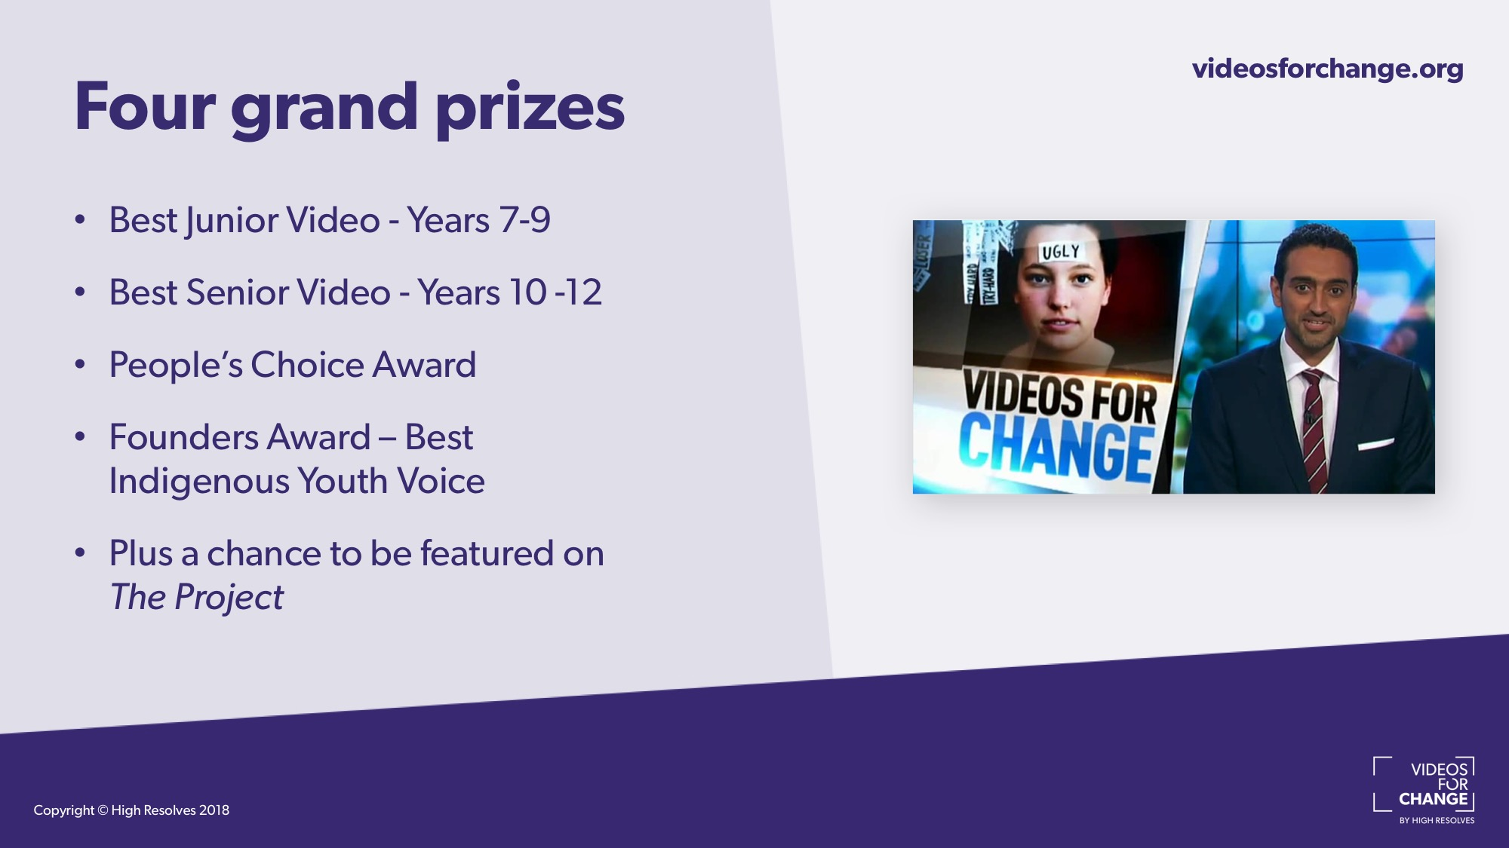
Notes:
Suggested Scripting
Explain that there have been some exciting changes this year, which include four grand prizes:
Best Junior Video – Years 7-9
Best Senior Video – Years 10-12
People’s Choice Award - The winner of this award is based on the finalist video with the highest number of votes, likes and shares on social media
Founders Award – Awarded to the best video representing the voice of indigenous youth. Please note that this may be awarded to any team that has at least one Aboriginal or Torres Strait Islander member.
Plus the chance to be featured on Network TENs, The Project to help them reach as many people as possible and make a really big impact to their chosen issue. Previous winners have reached over 1 million people!

Slide 4
Key Dates
Entries open June 24
Voting – People’s Choice Award: October
Winners Announced: mid November
Film Festival (Sydney) late November

Slide 5
Notes:
Suggested Scripting
Explain that everything they need to know about the challenge and how to enter can be found on the website: videosforchange.org. Also check out @VideosForChange on Facebook, Instagram for all of the latest Videos for Change news!
There are also lots of great resources to help them create their video on the site, including ‘how-to’ videos and past entries that they can watch for more inspiration!
Remind them that they don’t need to be expert filmmakers or have access to fancy equipment to win one of the grand prizes, it’s about being passionate storytellers who are dedicated to creating positive social change

