Slide 1
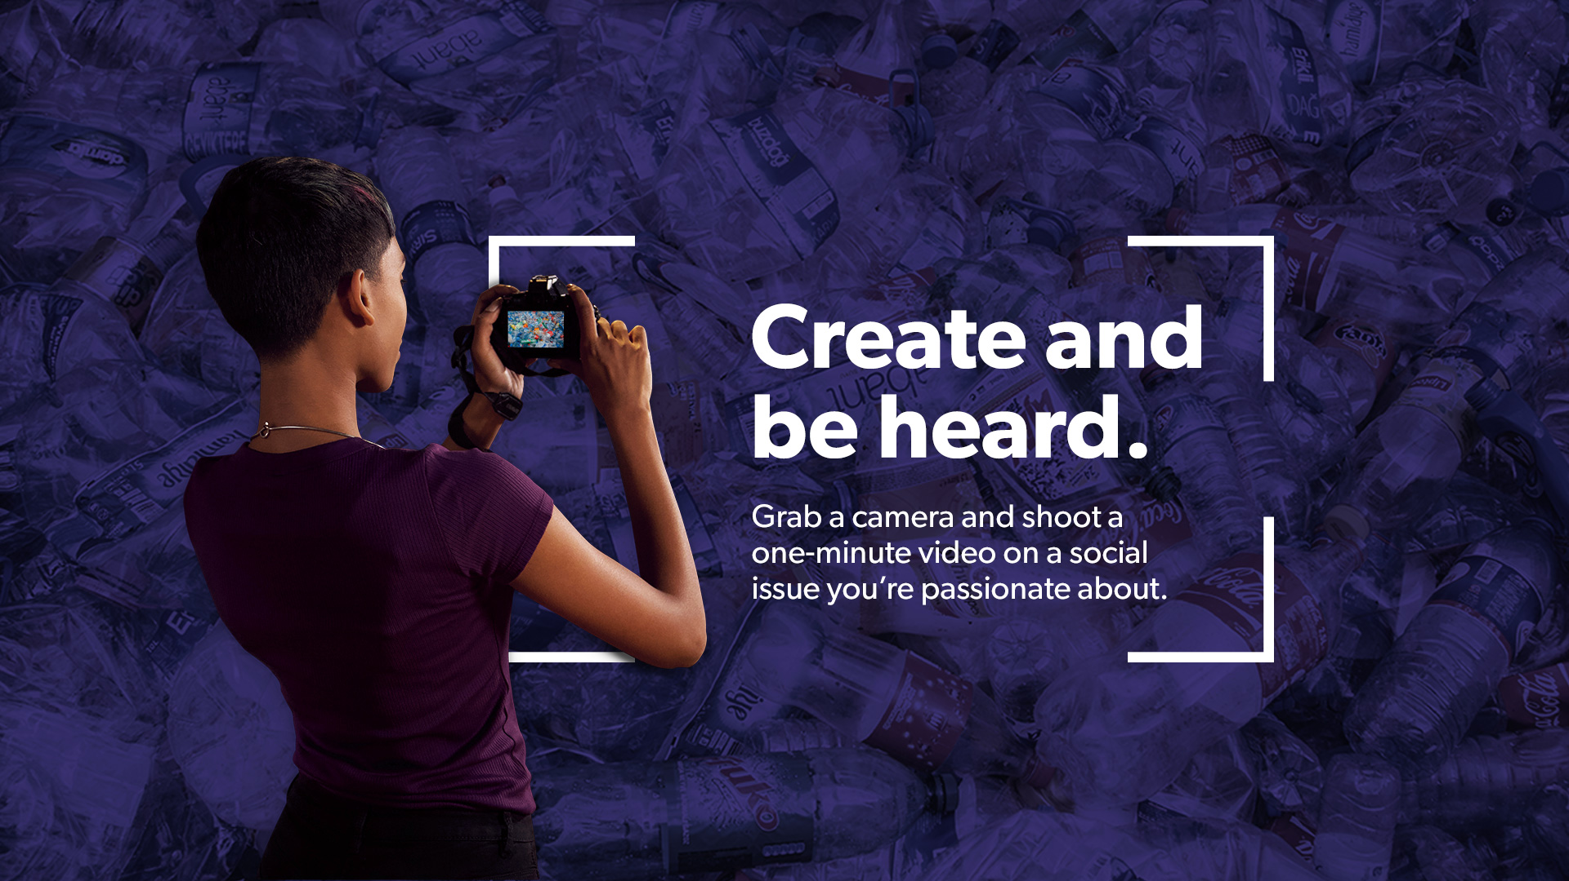

Notes:
Suggested Scripting
Videos for Change is a powerful way for students to create, be heard and lead social change

Slide 2
Notes:
Suggested Scripting
Briefly cover the guidelines: one-minute social action video, national challenge for students in Years 7-12, teams of up to 6 people (students are eligible to enter as individuals)
Explain that this is not just about the chance to win a competition but a unique opportunity to act as leaders by inspiring others to act in the long-term, collective interest of humanity to make the world a fairer and better place

Slide 3

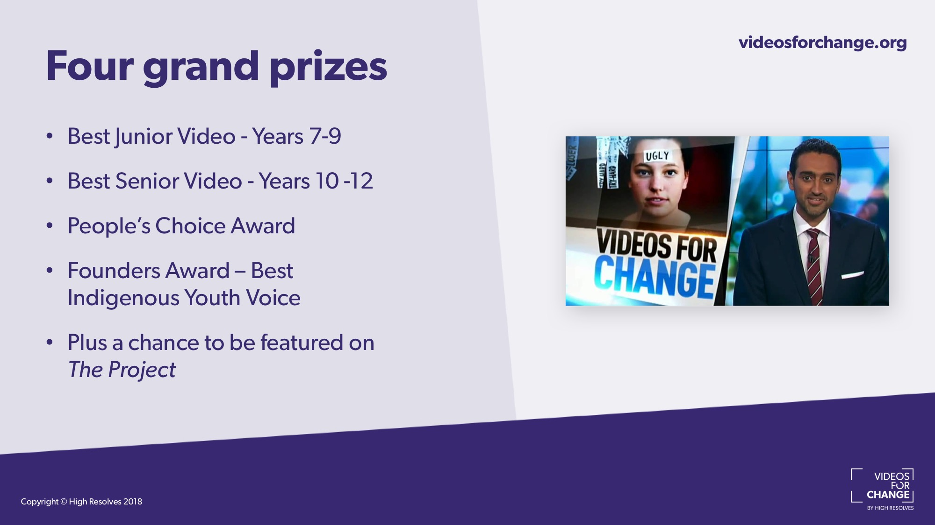
Notes:
Suggested Scripting
Explain that there have been some exciting changes this year, which include four grand prizes:
Best Junior Video – Years 7-9
Best Senior Video – Years 10-12
People’s Choice Award - The winner of this award is based on the finalist video with the highest number of votes, likes and shares
Founders Award – Awarded to the best video representing the voice of indigenous youth. Please note that this may be awarded to any team that has at least one Aboriginal or Torres Strait Islander member, who plays a significant role in creating the clip
Plus the chance to be featured on Network TENs, The Project, to help maximise their reach and supercharge their impact. Past entries have reached over 1 million people!

Slide 4
Key Dates
Entries open June 24
Voting – People’s Choice Award: October
Winners Announced: mid November
Film Festival (Sydney) late November

Slide 5
Notes:
Suggested Scripting
Students can find out more about Videos for Change and how to get involved in this year’s challenge at: videosforchange.org. They can also check out @VideosForChange on Facebook, Instagram for all of the latest updates
Build excitement and emphasise that there are also lots of great resources to help them create their video on the site, including ‘how-to’ videos and past entries that they can view for inspiration!
Reinforce that they don’t need to be expert filmmakers or have access to fancy equipment to win one of the grand prizes, it’s about being passionate storytellers who are dedicated to creating positive social change

